Slide 1
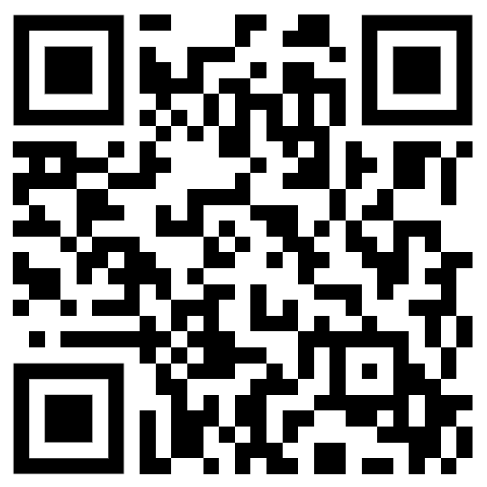
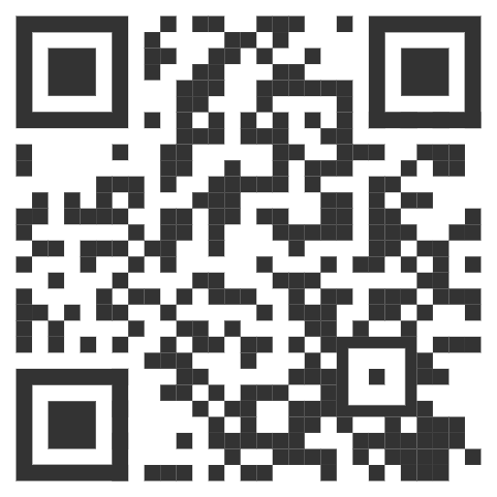
RESEARCH MENTORING WORKSHOP
RSVP HERE!
(SCAN/CLICK)
MONDAY, OCTOBER 16TH @ 12:30PM
ROOM E156, ENGINEERING BUILDING
LUNCH WILL BE SERVED!

