Slide 1
Thriving in a Research Environment
Program Name
Date

Slide 2
How do we connect opportunities to actionable research?
Notes:
Facilitator:
“Before we watch the introductory video for this workshop, let’s talk about making actionable, impactful progress in research. What are some characteristics of actionable progress in research?”
Collect ideas from students (on white board for a small group, Poll Everywhere or jam board for larger groups). Briefly discuss common themes. Likely themes relate to working or collaborating with someone else (stakeholders) to make progress in the research.
“Do you feel like your own project has clear action items? Could I get a few examples of why or why not?”
Allow a couple of students to share their ideas.
“An entrepreneurial mindset includes being forward-thinking to set and meet goals. There is a framework to help us do this. We’ll watch the video for this workshop now, which will introduce some steps you can take to make actionable, impactful progress in your research. As you watch the video, consider your own project, and how you might apply these ideas to your work.”
Watch the introductory video for this workshop.
[8 min, including video]

Slide 3
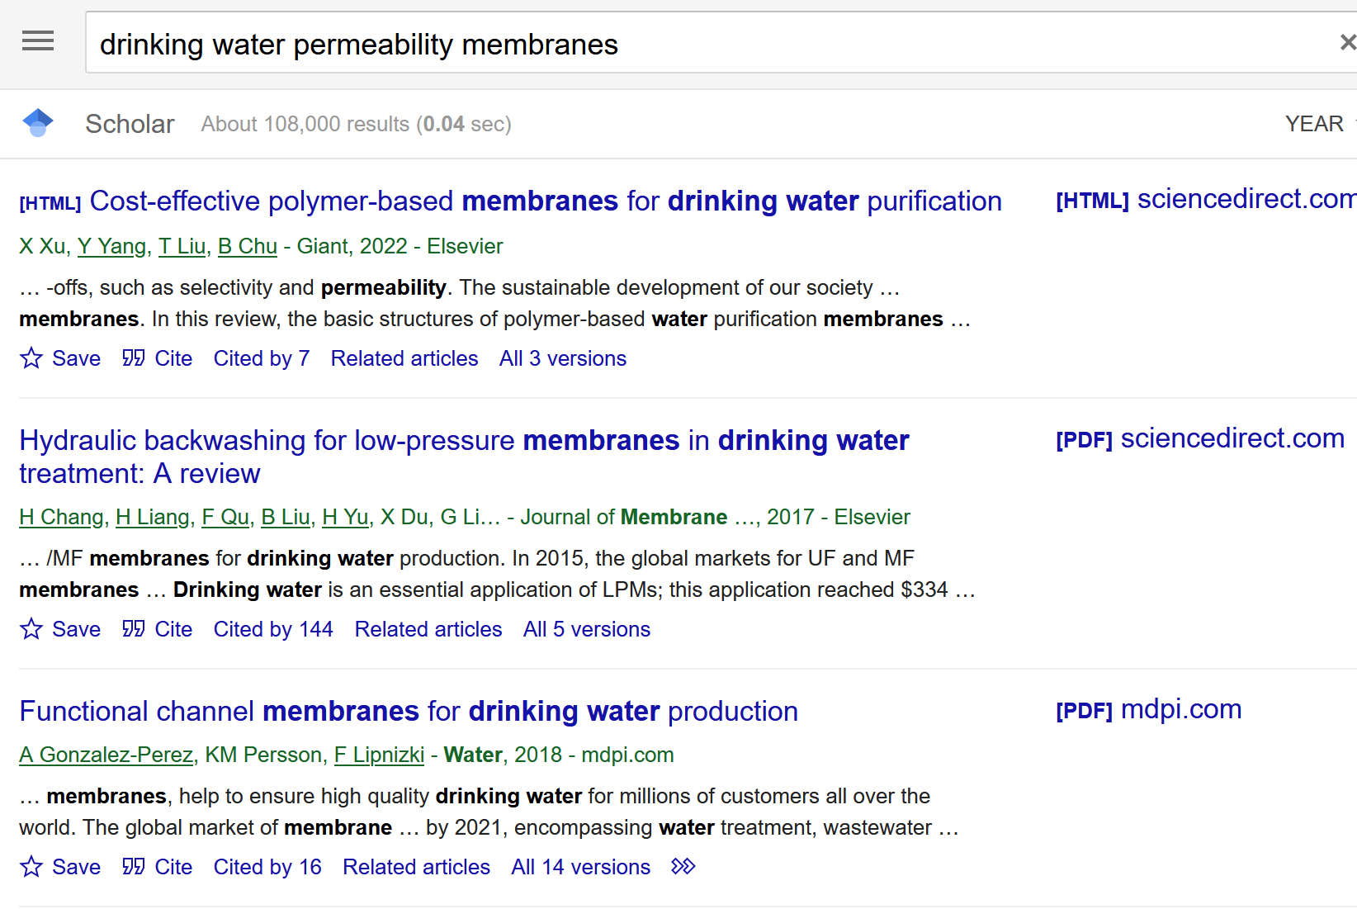
Goal setting is confident progress.
Research question: How can we maximize the permeability of biomimetic membranes?
Notes:
Facilitator:
“From the video, Tatiana was tasked with learning about what other research has found about the permeability of biomimetic membranes. When Tatiana first tries to just start her search, what happens and how does Tatiana feel?”
Solicit responses
For larger groups, it may help to use an electronic polling software like Poll Everywhere or a word cloud to collect student answers and then discuss after each poll. Small groups can share ideas in round-table style.
“To help Tatiana reduce feelings of overwhelm and make actionable progress, Tatiana works to develop a SMART goal to achieve what her PI asked her to do: get up to speed on previous research related to biomimetic membranes.”
[2 min]

Slide 4
SMART goal setting is just plain smart!
Research question:
How can we maximize the permeability of biomimetic membranes?
Tatiana’s SMART Goal:
Read and take notes on two journal articles every day for five days and compile her findings into a 1-page, IEEE-cited summary.
As she encounters articles, she will ask herself, “does this article address the permeability?”
Notes:
Facilitator:
“To help Tatiana feel confident in getting started on making actionable progress, Tatiana works to develop a SMART goal to achieve what her PI asked her to do: get up to speed on previous research related to biomimetic membranes. What does this SMART goal allow Tatiana to do?” Solicit a response or two.
If this idea isn’t offered, may wish to share: “Having the framework of a SMART goal not only allows Tatiana to do what her PI asked, it gives her confidence to think through her ability to progress in her research, allowing her to build a pathway towards specific outcomes and identify connections between those outcomes and stakeholders.”
“How does Tatiana’s SMART goal make you feel–is it something you think you could do and would it be actionable progress? Why or why not? Does it feel different from just starting a search without a goal?” Briefly solicit responses.
“Are there aspects of Tatiana’s SMART goal you think could be further refined or improved? How/what/why?” Solicit responses and discuss.
If time, add an additional connection: “as you practice writing SMART goals, you’ll start to feel more comfortable breaking down larger tasks into more bite-sized ones. Can you think of a time you went in the wrong direction or just couldn’t go farther because you hadn’t set up a good goal?” Use this question if there is time/energy to go down this path.
[10 min without the extra discussion]

Slide 5
Now I want to get SMART.
Research question:
Some overall goals you want to accomplish:
Notes:
Facilitator:
“We’ve looked at Tatiana’s example from the video. Now, try this for your own project. In the student workbook / slide deck, there’s space for you to formulate SMART goals. But first, let’s start with identifying some overall tasks or goals you want to achieve. These can be things you want to try in the lab or writing goals like Tatiana’s. Think of a few and then you can pick one to zero in on more.”
[3 minutes for students to write down own ideas]

Slide 6
SMART goals = questions + honest, forward-thinking answers.
Specific:
Measurable:
Achievable:
Relevant:
Time-bound:
Notes:
Facilitator:
“Now, for one of your overall goals, let’s look at each of the aspects of a SMART goal, starting with Specific. Tatiana asked herself, ‘Is it specific?’. So ask yourself, have you identified what needs to be accomplished? Who will you give/present/share this finding or task to/with? Where? How? Tatiana wanted to be able to report on the key research describing the permeability of biomimetic membranes.”
Give time for thinking/writing/sharing.
“For Measurable, be specific here too: what will be measured to know you have done what you wanted? In the end, Tatiana said she’d read and take notes on 10 articles. She could have said she’d spend a certain amount of time reading and writing, or that she’d write her notes out in bullet-point or prose form, or electronically or on paper. The point is to have the deliverable specified from the get-go. In other words, make the decisions before you even start so you really know what you’re doing.”
Give time for thinking/writing/sharing.
“For Achievable, research shows that a challenging, but possible goal is more likely to equal success than a goal that is too easy. On the other hand, your goal shouldn’t be so tough that you are unable to achieve it given your current resources/situation. Ask yourself, are there skills or resources that I need to acquire before I can embark on achieving this goal? Figuring these things out early means you will make more progress sooner, and have more time to be innovative and successful in your work.”
Give time for thinking/writing/sharing.
“For Relevant, ask some questions: How does the goal tie back to the research question? How does EM play a role? What value does this task bring to my work, the stakeholders, or even the end consumers? Do I need to prioritize?”
Give time for thinking/writing/sharing.
“For Time-bound, it is important to recognize deadlines and work backwards from there. Determine when you will start and when you need to finish. Does someone else need to review your work before it gets sent to an external stakeholder? What stakeholders need your data and by when? For example, when do my partners need the summary or results? Do you need to combine your deliverable with someone else’s? What do your schedule and your partners’ schedules look like in order to coordinate? Go back to the previous SMART goal item: be sure to be realistic when setting deadlines, or reign in your scope (the “what” in the beginning).”
Give time for thinking/writing/sharing.
“Identifying these aspects can be a challenging task because it forces you to be honest with yourself and make decisions upfront about how you will spend your time and effort.”
“After you’ve written down your ideas, turn to your neighbor to share what you have. Provide feedback on whether you think your neighbor might be missing any ways to make their goal truly measurable, etc. Remember, we are here to help each other become better researchers, and practice will make it easier over time. If you practice this technique, it will become reflexive and you won’t spend extra time–you’ll actually come out way ahead!”
After ~25 min, ask if there are 2-3 students who want to share their SMART goal. Allow constructive feedback afterwards.
Can note: “Your research mentor or advisor will also be a key resource in evaluating whether your goal is appropriate or not.”
[30 minutes for students to write down own ideas and discuss with neighbor]

Slide 7
SMART goals still need to be nurtured.
One thing I will do / give up is:
I will pay attention to _______________ when I do _____________.
Notes:
Facilitator:
“While it’s important to practice the SMART goal-setting technique, it can be as important to think about some additional items for success in achieving your research goals. The first can be a difficult one to commit to, but very important. It’s about being honest with yourself: “What is one thing I am going to do / give up / change about my daily routine to ensure I make progress towards my goal? Time is finite, so one way to think about this is to lay out your calendar and identify time you can work, and then schedule in your SMART goal progress time. Think about if you work better in the morning or afternoon, or when stakeholders may be available so you can potentially tap them as resources and be responsive to any feedback they may have. Another way to think about this is, for a task to be truly realistic, you need to have adequate time to complete it. So, maybe that means spending an hour less of screen time every day to get in reading/writing time, and maybe that means you need to close email, social media, and turn off your phone when you do this work. Write down what you might do / give up to commit to achieving your goal. Don’t worry if this is a hard question—it is for students, your professors, and most people!”
Give time for thinking/writing, then solicit responses. Discuss as appropriate.
For larger groups, it may help to use an electronic polling software like Poll Everywhere or a word cloud to collect student answers and then discuss after each poll. Small groups can share ideas in round-table style. Alternatively, students could share with a partner or small group if it might feel too personal to share these ideas to the whole class.
“Finally, are there any items you’d want to pay attention to when executing your goal? As Tatiana was finding articles, she was going to ask herself, “Does this article address the permeability?”. Are there additional instructions you want to share with your future self? Don’t let those thoughts go to waste—note them down!”
“It is also worth noting that goal setting with SMART goals is important, but so is accountability. Finding a support group (friends, family, spiritual leader, sports coach) can help you in achieving even the best-written SMART goals. Is there someone you could swap goals with or set up a coffee/tea or even just Zoom meeting with on a recurring basis to ensure your SMART goals are working for you?”
[7 minutes for students to write down own ideas and discuss as a class]

