Slide 1
Stopping Sight Distance and Dilemma Zone
CEE 372 Transportation Engineering

Slide 2
Recap: Practical Stopping Distance
Total Stopping Sight Distance
Distance traveled during perception-reaction
Braking distance
Textbook Equations
$$d_{s}=d_{r}+d=V_{1}{×t}_{r}+\frac{V_{1}^{2}}{2g\left(\frac{a}{g}±G\right)}$$
Typical values
$t_{r}=2.5s$ for geometric design, $1.0s$ for signal timing
Deceleration $a=11.2 ft/s^{2}$ for geometric design, $10 ft/s^{2}$ for signal timing
Sometimes also known as coefficient of friction
(consistent units)
Notes:
+/-: + for uphill; - for downhill; rule of thumb
Show equations in the Mannering & Washburn textbook Ch02 and Ch03

Slide 3
Application of SSD in Signal Timing

Slide 4
Yellow Interval
Dilemma Zone
Traffic light turns yellow when approaching intersection
Faces dilemma whether to apply the brakes to stop or attempt to clear the intersection
Notes:
Instructor can share personal stories of dilemma zone after Animation #1, and ask students to share their personal stories.

Slide 5
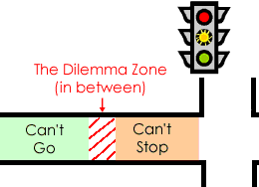
The likelihood of the existence of a dilemma zone on an approach decreases as:
the yellow time decreases
the yellow time increases
the number of lanes on the approach increases
the green time increases
12
10
0
3
9
8
2
15
4
13
1
11
5
6
14
7
Figure: https://www.thenewspaper.com/rlc/reports/rlcreport3.asp

Slide 6
Yellow Interval
Stopping Scenario
How much distance would a typical design vehicle need in order to come to a full stop after the light turns yellow?
$$d_{stopping}=v∙t_{r}+\frac{v^{2}}{2a±2gG}$$
Clearing Scenario
How much distance would a vehicle approaching the intersection at speed limit travel during the yellow interval $Y$?
$$d_{clearing}=v∙Y$$

Slide 7
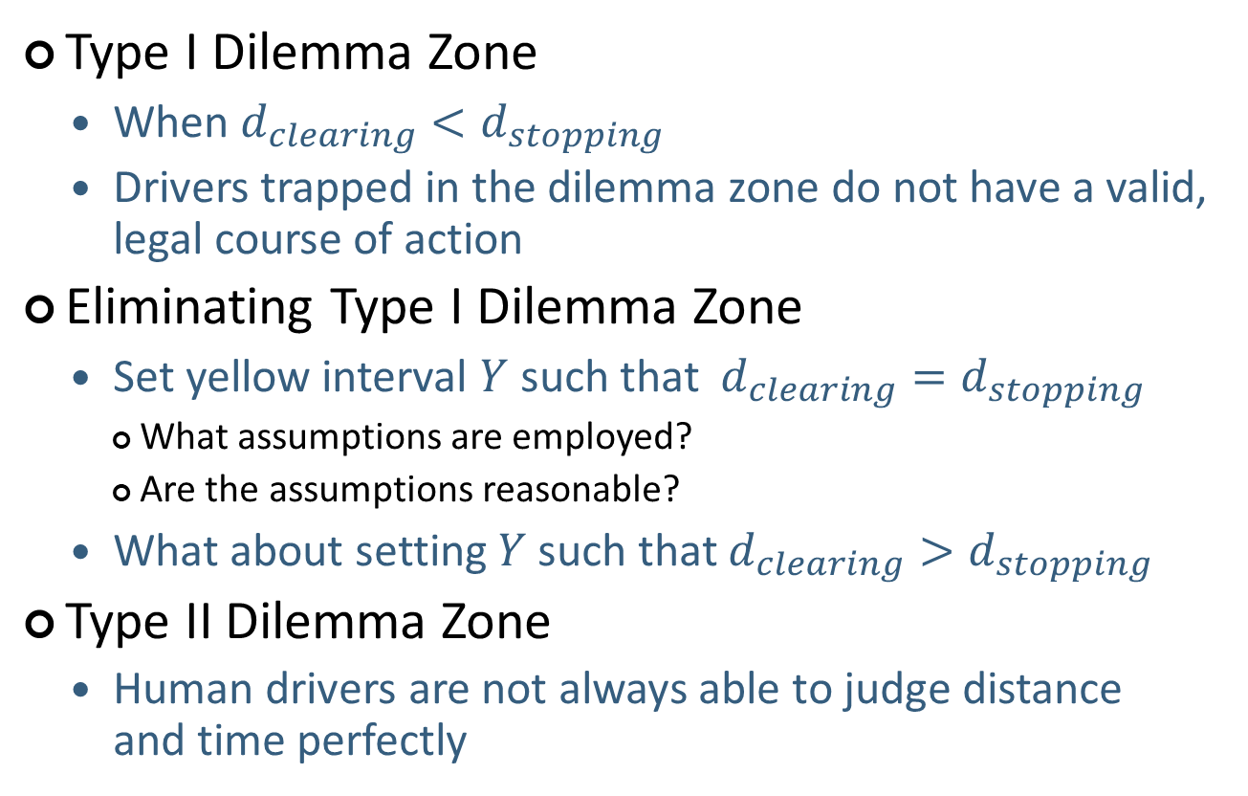
Yellow Interval
Type I Dilemma Zone
When $d_{clearing}<d_{stopping}$
Drivers trapped in the dilemma zone do not have a valid, legal course of action
Eliminating Type I Dilemma Zone
Set yellow interval $Y$ such that $d_{clearing}=d_{stopping}$
What assumptions are employed?
Are the assumptions reasonable?
What about setting $Y$ such that $d_{clearing}>d_{stopping}$
Type II Dilemma Zone
Human drivers are not always able to judge distance and time perfectly
Notes:
Ask students can we set

Slide 8
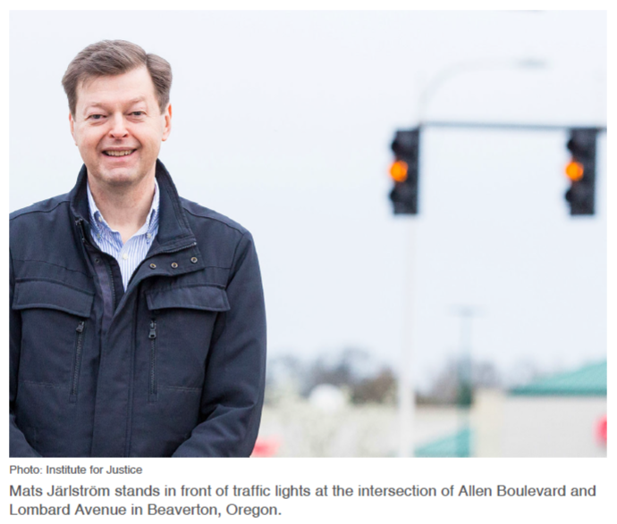
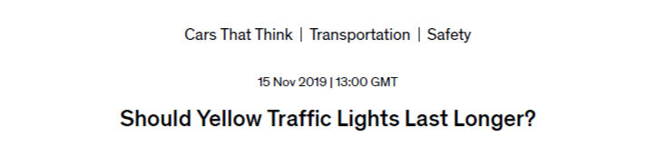
Individual Project Overview
Notes:
Individual Project materials can be found in the Folder’s section under ”Research Project”

