Slide 1
WELCOME TO THE COE FACULTY MENTORING WORKSHOP
NOVEMBER 30, 2022
Notes:
Allow 10 minutes for coming in, getting food, and sitting down. Start after 10 mins.

Slide 2
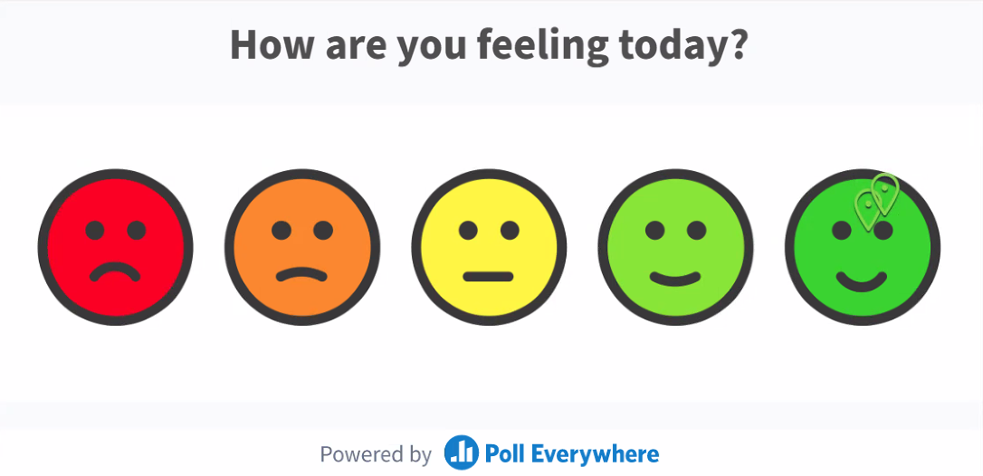

Slide 3
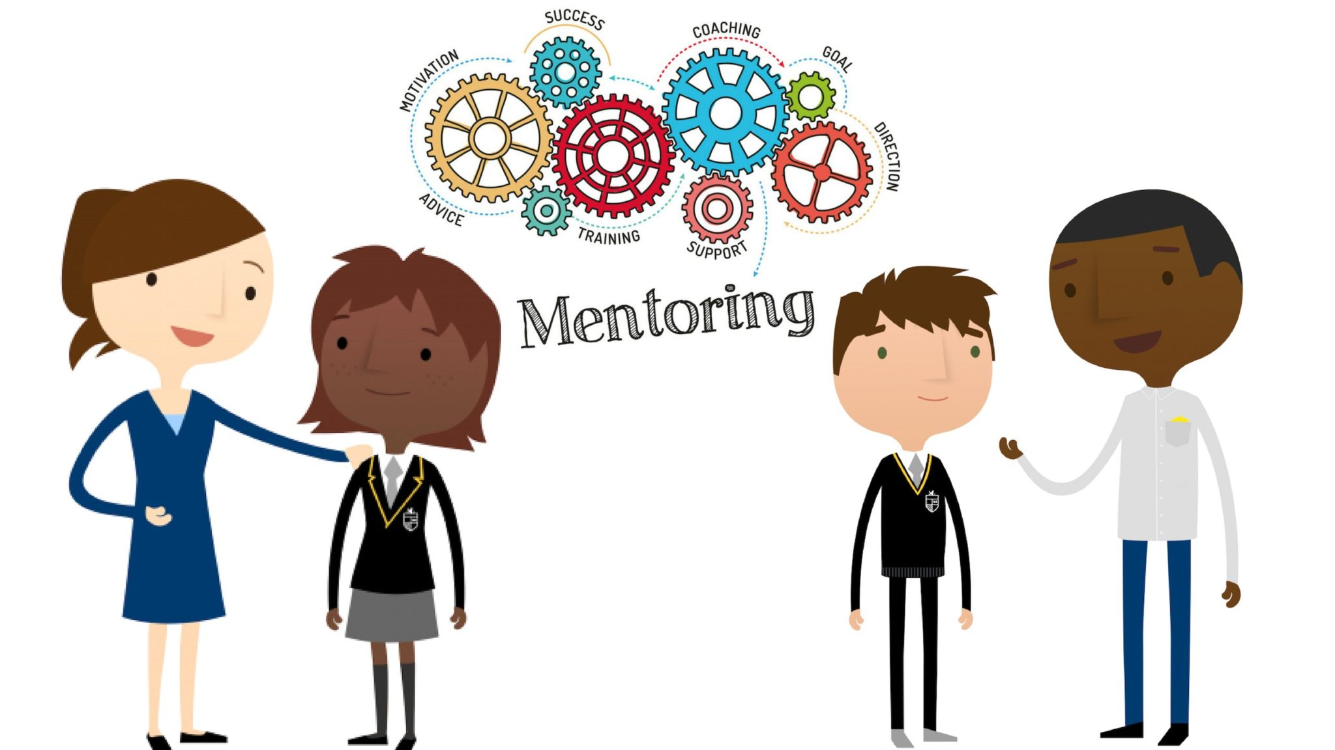
What Are the Three Words Coming to Your Mind When You Think of Research Mentoring?
Word Cloud Activity

Slide 4
Do You Have a Framework for Mentoring Student Researchers?
Notes:
Do you have a checklist of items to use when first meeting with a new student?
Do you have

Slide 5
Student Research Training
Skillset
Mindset

Slide 6
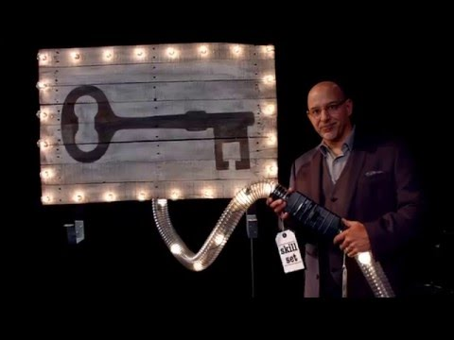
Why Entrepreneurial Mindset Matters

Slide 8
A Collaborative Project Funded by the Kern Family Foundation

Slide 9
Project Plan
Early Exposure & Awareness
Understand Student Motivation
Boost the Productivity of UG Research with EM
Partner & Collaborate
Efficient Team Training
Faculty & Mentor Development

Slide 10
Student Research Training Workshops
Framing Research Questions
Developing Your Research Pitch
Thriving in a Research Environment
Effective Data Presentation
Building Resilience in Research
Maximizing the Impact of Your Research
Coming soon in 2023!
Please encourage your students to attend!

Slide 11
Project Plan
Early Exposure & Awareness
Understand Student Motivation
Boost the Productivity of UG Research with EM
Partner & Collaborate
Efficient Team Training
Faculty & Mentor Development

Slide 12
Making the First Connection
Role 1: You are a faculty
Imagine today you are having your first meeting with a new research assistant, what is on your checklist of things to discuss with them?
Role 2: You are a student
Today you are having your first meeting with your research advisor. What kind of questions do you have about this research project or research in general?
Please add your answers here: tinyurl.com/EMResearchWorkshop
You have 10 minutes to put in answers.
Notes:
Facilitator: Divide your audience into groups of four.
How EM can help you more meaningfully engage students.
We all had success stories of EM in teaching.
Think of one good example you did in class. Share your ideas.
Can you develop similar practices in research mentoring?

Slide 13
Examples: Making Connections in Research
Integrate information from many sources to gain insight
Assess and manage risk
Examine societal and individual needs
Form and work in teams
Understand the motivations and perspective of others
Convey engineering solutions in economic terms
Substantiate claims with data and facts
QUESTION: What would be your first step to help students see connections during a research experience?

Slide 14
Activity: What would be your first step to help students see connections during a research experience?
FRONT: ANSWER
Compare the approaches of three different research teams
BACK: RANKING
2
4
1
SUM: 7

Slide 15
Now, Let’s Make A Plan…
Current Practices - You probably already use EM! How you can you expand it?
New Ideas - What did you hear today that you liked?
Planning - What are some concrete examples of changes you can make?
Timeline - How will you implement your plan? When are your target dates?
Follow-up - Meet with us to discuss your research mentoring process.
Report and Stipend - Fill out the follow-up report one year from now to receive a $500 stipend for implementing your plan. Your plan should involve long-lasting changes incorporating EM in your research mentoring of all your students.

