Slide 1
Bio-inspired Design
J.K. Nagel © 2013

Slide 2
Design by Analogy
Analogy: Similarity in some respects between things that are otherwise dissimilar; a comparison between two things, typically for the purpose of explanation or clarification.
Analogies can be used to solve problems, by recognizing when the design task is similar to a previously solved problem.
A 2011 study measuring the ideation performance of senior engineering students (N =153) found that ideas stimulated by far-field analogies (out of domain) were more likely to be novel (innovative) than others.

Slide 3
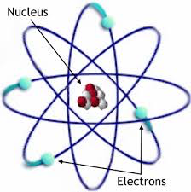
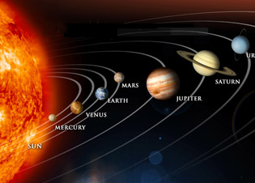
The motion of electrons about the nucleus of an atom is analogous to the Earth’s rotation about the sun.

Slide 4
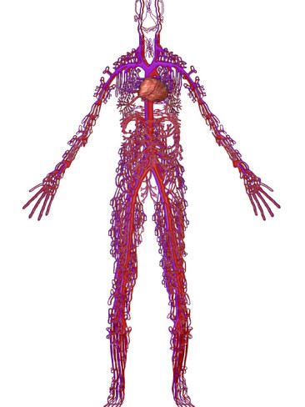
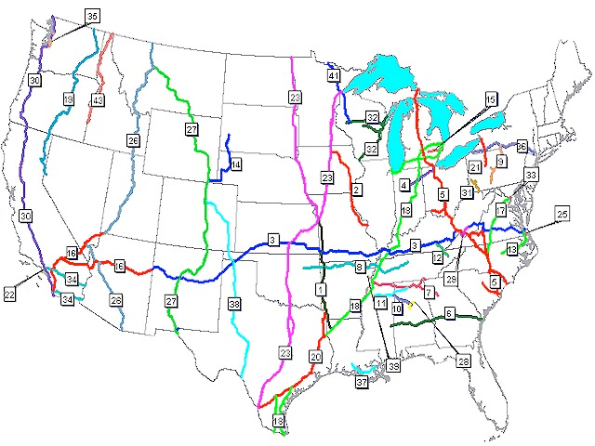
A blood clot is analogous to a traffic jam and prevents the blood cells from making their vital deliveries.
Notes:
blood clot is like a traffic jam preventing the blood cells from making their vital deliveries

Slide 5
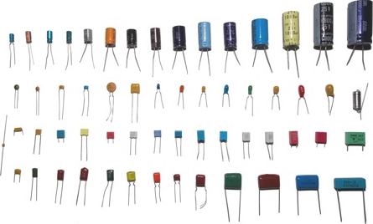
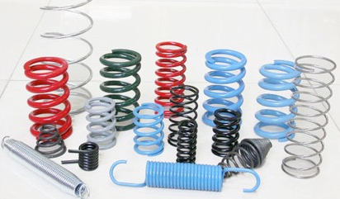
Analogies within Engineering
What mechanical device is analogous to a capacitor?
Capacitors
Springs

Slide 6
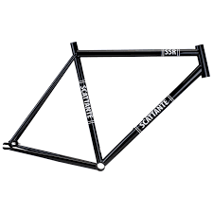
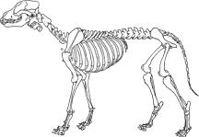
Analogies Outside Engineering
What in nature is analogous to a bike frame?

Slide 7
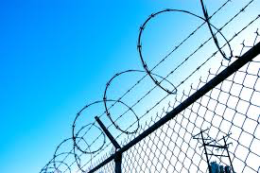
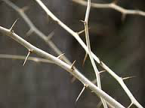
Analogies Outside Engineering
What in nature is analogous to a barbed wire?

Slide 8
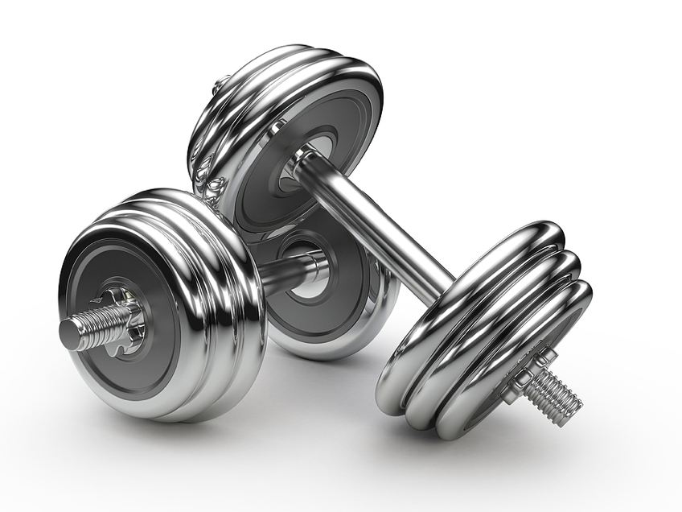
Analogy Example
Exercise equipment - Develop a concept for an exercise device capable of being easily carried in a suitcase
What items have a full weight version and also a portable and lightweight version?
Notes:
-Portable
-Lightweight

Slide 9
Analogy Example
Exercise equipment - Develop a concept for an exercise device capable of being easily carried in a suitcase
What are items that are lightweight and portable?
Notes:
OLD SLIDE

Slide 10
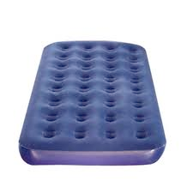
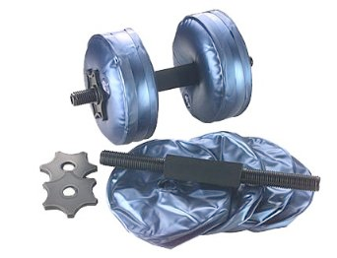
Analogy Example
Exercise equipment - Develop a concept for an exercise device capable of being easily carried in a suitcase
The key relationship that is used in both devices is they “use a fluid (or another substance) at the location where they are being used and export the fluid allowing for easy storage”
Notes:
-Portable
-Lightweight

Slide 11
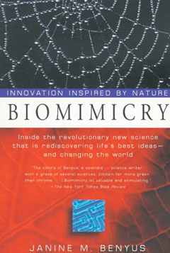
Bio-inspired Design
A particularly intriguing source of analogies is those that are inspired by biological systems.
Analogical reasoning requires creative thinking or lateral thinking – using the right side of the brain.
Not popularized until the 1990s, when Janine Benyus founded the Biomimicry Guild and wrote a book on Biomimicry.
Notes:
--- The intersection of the life sciences, engineering, and physical sciences, and it is leading to an ever deeper understanding of how life works
--Natural systems have evolved to their current form, providing the blueprints for what works
--Offers a unique viewpoint that engineers would not otherwise have
--Studying nature and applying nature’s solutions to engineering problems can lead to technical innovation

Slide 12
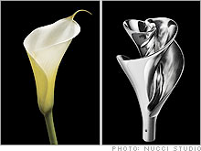
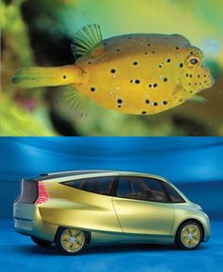
Bio-inspired Design
The term biomimicry comes from the Greek words:
bios–meaning life
mimesis–meaning to imitate
Purpose of Biomimicry: To study and imitate nature to solve human problems
Bio-inspired Design: Discovery of non-conventional solutions to problems that are often more efficient, economic and elegant
Notes:
Why is this important? - Learning from nature challenges us to think about the problem differently, apply our engineering knowledge differently -- encourages one to challenge convention and what is known... --Offers a unique viewpoint that engineers would not otherwise have
--- The intersection of the life sciences, engineering, and physical sciences
- leading to an ever deeper understanding of how life works

Slide 13
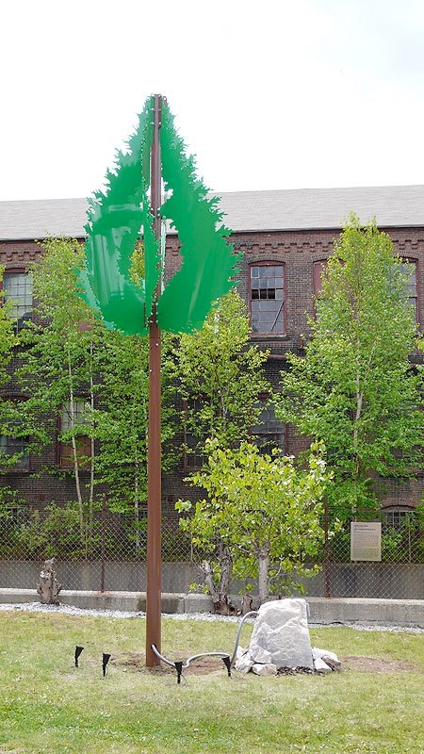
What it is not...
Bio-utilization
Acquiring the biological product or producer
Bio-assisted
Using the biological product or producer in the design to accomplish a function
Notes:
- Bio-utilization - Sustainable harvest of spider silk
- Bio-assisted - Using spider silk for a collection mechanism

Slide 14
Inspiring Innovation
The focus is not on what we can extract from the natural world, but what can we LEARN from nature
Challenges one to think about the problem differently, and apply engineering knowledge differently
Notes:
Why is this important? - Learning from nature challenges us to think about the problem differently, apply our engineering knowledge differently -- encourages one to challenge convention and what is known...
--These are diatoms, single celled “creatures” that live in water or underwater and perform photosynthesis.
--They have glassy shells made by precipitation of silicate on to a template.
--This process is being investigated for a biomimietic method of making intricate, microscopic silicon structures for electronics.

Slide 15
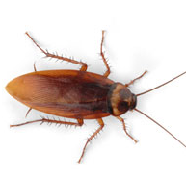
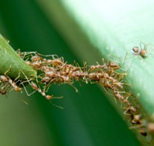
Function
Structure
System
Physical and Non-physical Characteristics to explore
Form
Process
Surface
Material
www.asknature.org

Slide 16
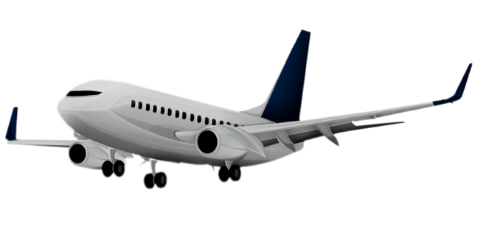
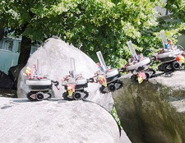
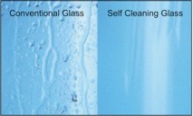
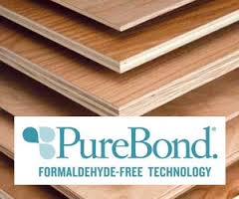
Function
Structure
System
Physical and Non-physical Characteristics to explore
Form
Process
Surface
Material
www.asknature.org

Slide 17
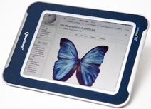
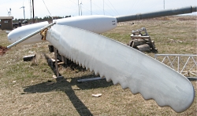
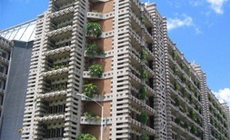
Learning from Nature to Innovate
How to utilize available light
Color display viewable in sunlight
How to efficiently use materials
Lightweight
armor
How to capture wind energy at low speeds
High efficiency fan or turbine blades
How to build strategic, sustainable architecture
Self-heating &
cooling building
www.asknature.org; www.treehugger.com/; www.moc.noaa.gov; freethinkr.files.wordpress.com; matsci.ucsd.edu; www.whalepower.com
Notes:
Transition what similarities have you noticed about the natural systems and the engineered systems they inspired? - Hopefully someone says they have the same shape or form or morphology

Slide 18
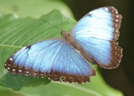
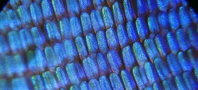
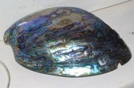
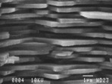
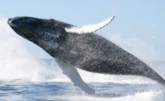
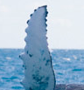
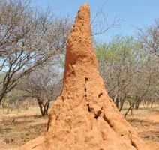
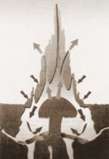
What Inspired These Innovations?
Color display viewable in sunlight
Lightweight
armor
High efficiency fan or turbine blades
Self-heating &
cooling building
www.asknature.org; www.treehugger.com/; www.moc.noaa.gov; freethinkr.files.wordpress.com; matsci.ucsd.edu; www.whalepower.com
Notes:
-- Light is reflected rather than created, each pixel is an optically resonant cavity
-- Controlled layering creates a stronger material
-- Internal channels create flow and naturally heat and cool the structure

Slide 19
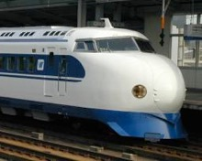
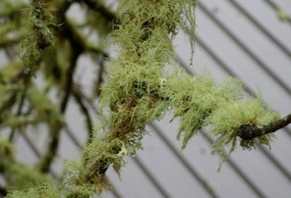
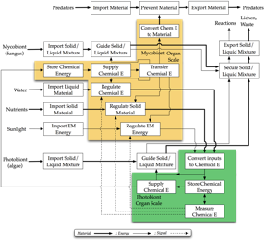
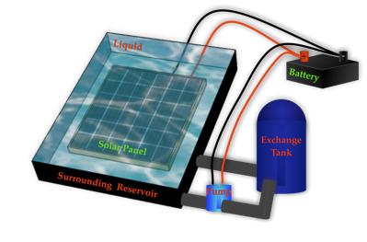
Follows Two Major Paths
Problem-Driven
Biology-Driven
Nagel, J.K.S., Stone, R.B., McAdams, D.A. (2013) “Function-based Biologically-Inspired Design.” Chapter 5 in Biologically Inspired Design: Computational Methods and Tools, Springer
Notes:
--Problem: The Japanese Shinkansen bullet train (traveling at 185 mph) encountered air pressure changes every time the train emerged from a tunnel, causing large thunder claps heard up to one-quarter a mile away
-- Ask: how can we abstract the problem?
--The beak of kingfishers allows splashless entry into water due to the wedge shape it makes with the head that is round in cross section. Although the medium is different, water VS. air, the biological system can still be used for inspiration. This is an abstraction about the form.
--Modeling the front-end of the train after the beak of kingfishers, which dive from the air into bodies of water with very little splash to catch fish, resulted not only in a quieter train, but 15% less electricity use even while the train travels 10% faster.

Slide 20
At a high level...
Apply biological inspiration to
solve the problem
Abstract the
problem to
be solved
Connect
Problem
Identify analogies to engineering, governing principles
Search for
biological
inspiration
Reflect
Identify
Abstract
Abstract the biological information
Notes:
-- Here is a process that summarizes how to use abstractions effectively
-- It helps one to make connections between the domains to facilitate discoveries....
-- Everyone brings a different perspective and background and therefore, during the reflection step an EE will most likely come up with a different analog than say a Chem E.
--Physiology:: What :: How an organ works, respiration, reproduction, wing flapping pattern,
--Morphology:: How :: The shape, the layering of materials, the microscopic details
--Behavior:: Why :: Change shape to cause fear in enemy-frill lizard, puffer fish

Slide 21
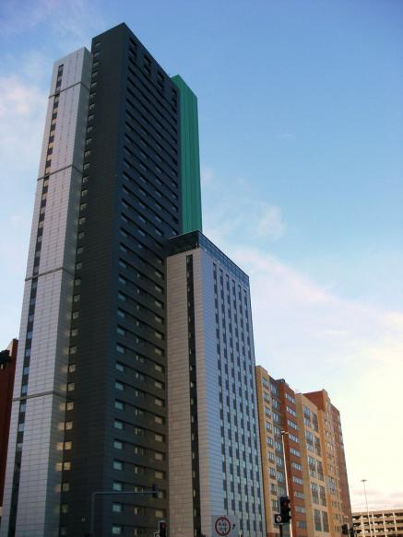
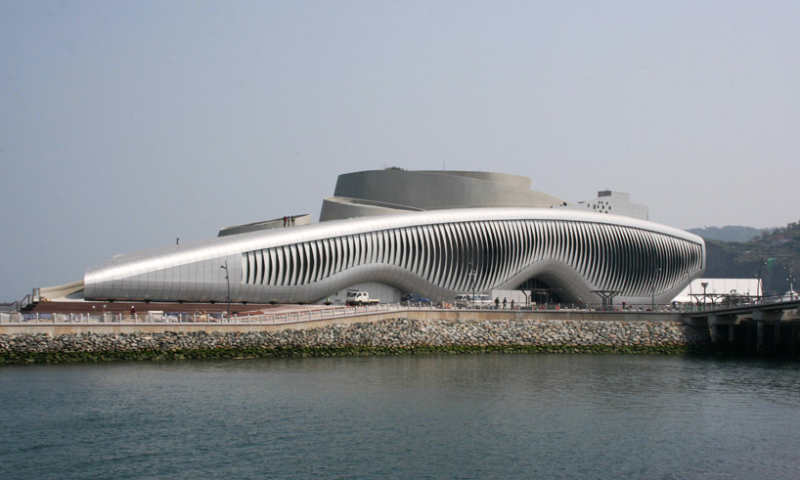
The Process of Discovery starting from a problem
Shading buildings with irregular geometries is very difficult since most sun protection systems were developed for planar façades.
The pollination mechanism of the Bird-of-Paradise flower offered inspiration based on the elastic kinematics of plant movements.
Notes:
--- Instead of connecting rigid elements with strained hinges, plant structures gain their flexibility by differentiating morphological and anatomical features to create an all-in-one pliable system.

Slide 22
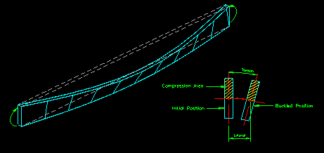
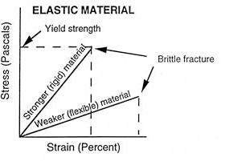
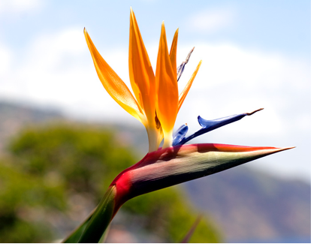
The Process of Discovery
Concept Space
Knowledge Space
C0: Design an adaptable and energy efficient facade shading system
Existing Solution
Hinges and rollers used in building shading systems (blinds) wear and require maintenance. Only work well for square buildings.
C1: With hinges
C1: Without hinges
Traditional Knowledge
Biological system: Bird of Paradise
C2: Reversible elastic deformations
C2: Non-reversible elastic deformations
C2: Lateral torsional buckling
Reversible deformation, bending the perch unfolds the petals exposing the pollen
Unexpected Property
Absence of local hinges
C3:
Biology Knowledge
Design Path
Notes:
--- Instead of connecting rigid elements with strained hinges, plant structures gain their flexibility by differentiating morphological and anatomical features to create an all-in-one pliable system.

Slide 23
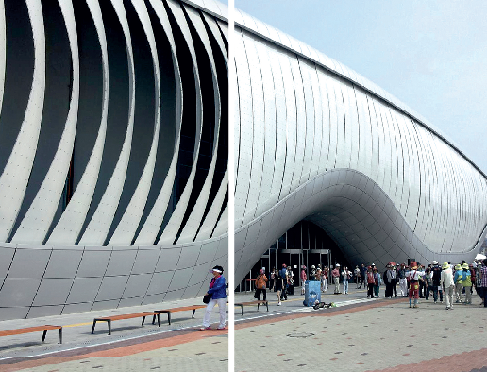
The Process of Discovery Resulted in Technical Innovation
Notes:
--- Instead of connecting rigid elements with strained hinges, plant structures gain their flexibility by differentiating morphological and anatomical features to create an all-in-one pliable system.

Slide 24
Bio-inspired Design applied to the Human Powered Vehicle
Taking inspiration for the entire HPV is not productive (just like taking inspiration for the facade system and not the entire building)
Our goal is to arrive at sub-system solutions that can be added to the morphological matrix and used in the second round of concept generation
Lets focus on propulsion....
Notes:
--- Instead of connecting rigid elements with strained hinges, plant structures gain their flexibility by differentiating morphological and anatomical features to create an all-in-one pliable system.

Slide 25
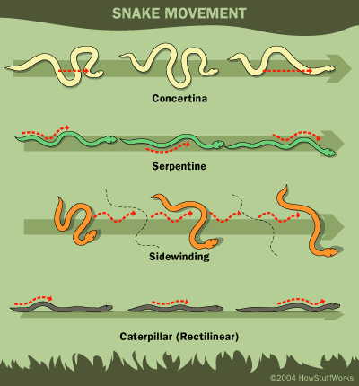
HPV Example
Concept Space
Knowledge Space
C0: Design a human powered vehicle propulsion system
Existing Solution
Gears with a chain will produce propulsion when turned with a pedal.
How does this biological information connect to what I know, or what is known?
C1: Using pedaling motion
C1: Without using pedaling motion
Traditional Knowledge
Biological system: Snakes
Unexpected Property
Snakes use their muscles and scales to move in four different ways: serpentine motion, concertina motion, sidewinding, and rectilinear motion.
Propulsion is by lateral thrust in all segments of the body in contact with the ground
Snakes use lateral undulation to move quickly across the ground and push off of bumps to get going.
Biology Knowledge
Design Path

Slide 26
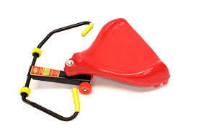
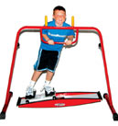
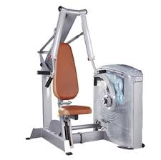
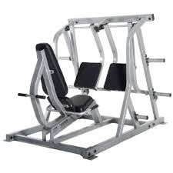
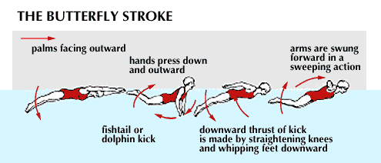
HPV Example
Concept Space
Knowledge Space
C0: Design a human powered vehicle propulsion system
Existing Solution
Gears with a chain will produce propulsion when turned with a pedal.
C1: Using pedaling motion
C1: Without using pedaling motion
Traditional Knowledge
Biological system: Snakes
Unexpected Property
Snakes use their muscles and scales to move in four different ways: serpentine motion, concertina motion, sidewinding, and rectilinear motion.
Propulsion is by lateral thrust in all segments of the body in contact with the ground
Snakes use lateral undulation to move quickly across the ground and push off of bumps to get going.
Biology Knowledge
Design Path

Slide 27
HPV Example
Concept Space
Knowledge Space
C0: Design a human powered vehicle propulsion system
Existing Solution
Activities/machines that cause movement in a serpentine or sidewinding motion? - Skiing, swimming, roller racer.
Activities/machines that cause movement in a concertina motion? - leg and chest press
Gears with a chain will produce propulsion when turned with a pedal.
C1: Using pedaling motion
C1: Without using pedaling motion
Traditional Knowledge
Biological system: Snakes
C2: Feet move in a side-to-side pattern like skiing
C2: upper body and feet move in a side-to-side motion like roller racer
C2: hands and feet press simultaneously like leg and chest press
Unexpected Property
Snakes use their muscles and scales to move in four different ways: serpentine motion, concertina motion, sidewinding, and rectilinear motion.
Propulsion is by lateral thrust in all segments of the body in contact with the ground
Snakes use lateral undulation to move quickly across the ground and push off of bumps to get going.
Biology Knowledge
Design Path

Slide 28
Closing Remarks
Biomimicry is a problem solving lens, which has resulted in technical innovation
Requires clear understanding of the problem
Asks “How would nature .... ?”
The focus is not on what we can extract from the natural world, but what can we LEARN from nature
Bio-inspired design facilitates discovery of innovative solutions without requiring expert-level knowledge, but rather a broad knowledge of many fields

