Slide 1
Stakeholder-Feature Models
Mapping the people who use your design to the features they most care about.

Slide 2
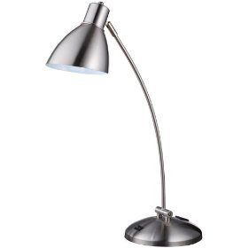
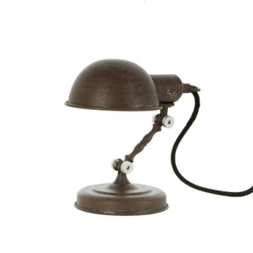
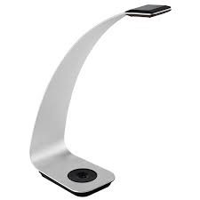
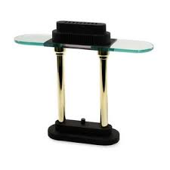
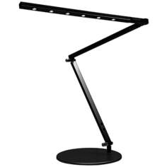
Desk Lamp Example: Stakeholder-Feature Model
Representations are not Physical Objects! What a desk lamp physically looks like varies greatly but desk lamps as a class of objects share similar attributes. However even in creating an object as simple as a desk lamp there are many points of view that need to be considered which are captured by design representations.
The representation known as a Stakeholder-Feature models will help you match up what the stakeholders in your lamp design (your client, users, etc.) want as the specific features you need to design in.

Slide 3
Describe the System in Terms of Stakeholders and Features
First focus on the human aspects of the problem
Stakeholder: Any person, group, organization, entity, etc. that has a vested interest in the system.
Feature: Any general characteristic, outcome, result, property, etc. of the system that is expressed in the Stakeholder’s language. Usually, but not always, these are –able words such as reliable, affordable, etc. One or more features should describe the system’s primary purpose- put an * next to these.
Considering the entire lifecycle of the system helps to identify stakeholders and features:
Need for System (problem)
System Development
System Manufacture
System Use
System Maintenance
System Disposal
3rd Order Stakeholders
2nd Order Stakeholders
1st Order Stakeholders
System has Features

Slide 4
It helps to make tables like the one below that list and describe the stakeholders and the respective features that they want from the system. Not all Stakeholders are of equal importance so think about and identify which are the primary stakeholders. Remember to consider the entire lifespan of the project when thinking about Stakeholders and Features.
Stakeholder | Importance High, Med., Low | Description
Feature | Description
Notes:
Need to describe that not all Stakeholders are of equal importance. They need to identify which are the primary stakeholders. The entire lifespan of the project should be accounted for when thinking about Stakeholders and Features.

Slide 5
To create a Stakeholder-Feature Model use the list you made to draw a map between the stakeholders and their respective desired features. Use different colors or thicknesses of lines and fonts to highlight the relative importance of both your stakeholder and what features that particular stakeholder is most interested in.
Stakeholder 1
Feature
1
Highly Desirable
Desirable
Somewhat Desirable
Stakeholder 2
Feature
2
Stakeholder 3
Feature
3

Slide 6
The list below will help you in created this model.
Common Stakeholders
End user
Client
Other engineers or scientists
Regulatory agencies
Those who maintain, repair, or update
Societal groups (i.e. government, police/fire depts, new generation of teenagers)
Manufacturers
Shipping department
Marketing/Sales/Retail department
Legal department
Those responsible for disposal/deletion of software
Common Features
Something to describe the projects primary purpose
Affordable
Small-size/form factor/weight (compactness)
Easy to use
Adaptable
Recyclable
Secure
Robust
Efficient
Environmentally friendly
Simple
Repairable
As and after you put your stakeholder-feature model together you need to be able to answer these questions:
Why do these stakeholders rate that feature as more or less important?
Why are you including features that don’t have strong connection to at least one stakeholder?
Are many weak connections from a stakeholder to a feature as important as one strong connection?
Will your system not work if any one of these stakeholders or features are removed?
Note that this exercise forces you to make choices and to make hidden assumption explicit. You can’t satisfy all stakeholders completely and the ones whose needs you choose to focus on steers your design. Such choices are integral to design.

Slide 7
Example: Desk lamp Stakeholder-Feature Model
Stakeholder Feature
Consumer
Utility
Retailer
Manufacturer
Energy efficient
Aesthetic
Dimmable
Small solid angle
Adjustable
Affordable
UL Listed

Slide 8
Figure 1: “Good” example of a Stakeholder-Feature Model from 15-16 project

